Slide 1
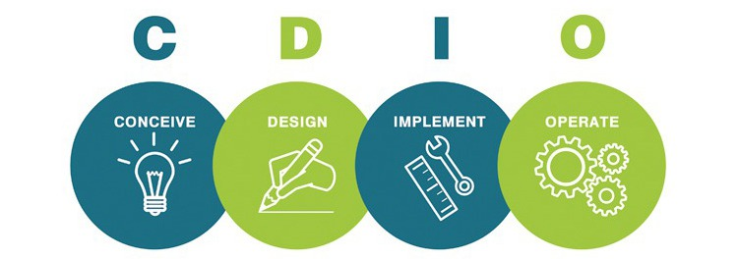


Introduction to CDIO
HELEN TEH 21 NOV 2014 & NOREEN KAMARUDDIN 25 NOV 2014
Notes:
How many of you have heard of CDIO? CDIO is an acronym.
Can anyone tell me what C, D, I and O stand for?

Slide 2




MISMATCH
Engineering Education
VS
INDUSTRY DEMAND OF ENGINEERS
Background …
Too MUCH on teaching of theory
Too little on laying the foundation for practising design, teamwork & communication
Notes:
I am going to share the background to the CDIO initiative. In the early 1990s, engineering educators all over the world were getting very concerned about the mismatch in the attributes of engineering graduates and the attributes industries were looking for.
Firstly, there was too much emphasis on teaching of theory. This was not helped by the fact that there was a knowledge explosion with the advent of the internet. Secondly, there was too little emphasis on practise, design and communication.

Slide 3
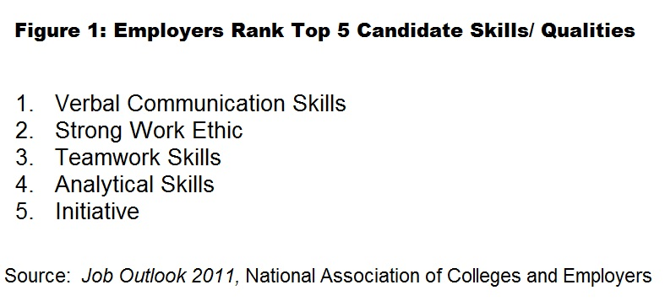

Cont…Background
MISMATCH
Graduate Attributes
VS
INDUSTRY DEMAND OF ENGINEERS
High Unemployability Rate
Notes:
The National Association of Colleges and Employers in the US conducted a survey in 2011. The results, published in Job Outlook 2011 indicate that verbal communication skills, strong work ethics, teamwork skills, analytical skills and initiative were the 5 top skills they look for in potential employees. This mismatch let to high unemployability rates among graduates.

Slide 4
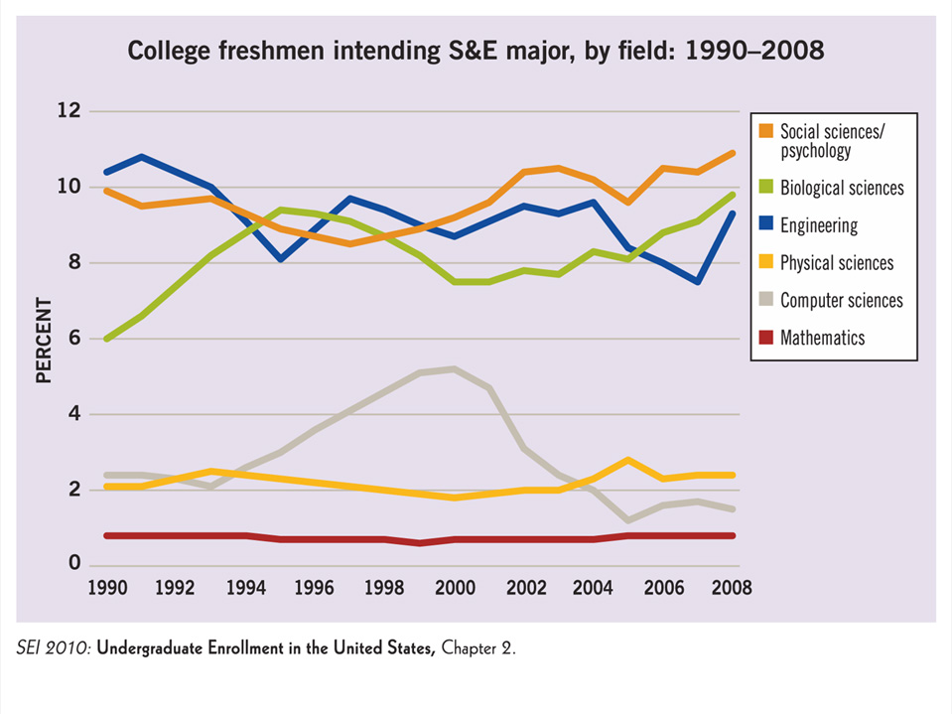
Cont…Background
Interest in engineering and engineering profession ↓
Notes:
The 2010 Science and Engineering Indicators Report in the US presented the following line graphs showing the college enrolment of students between 1990 – 2008. Notice in the early 1990s, there was a steep drop in the enrolment of engineering students. Part of the reason was engineering graduates could not get a job easily.

Slide 5
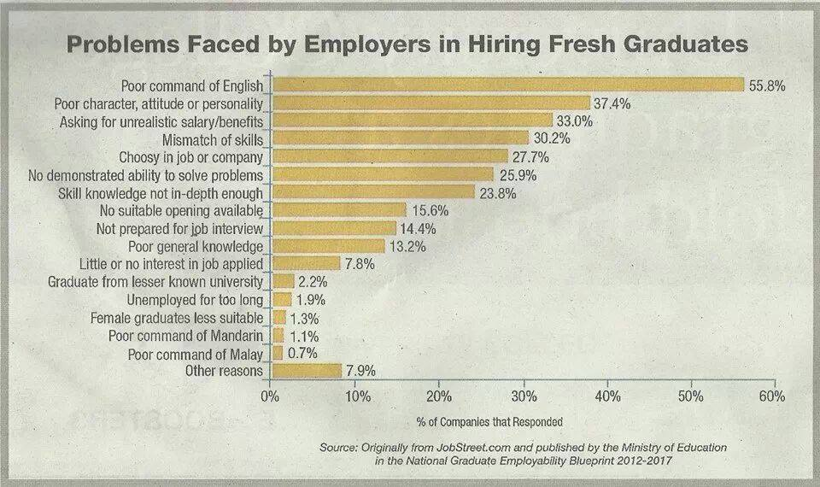
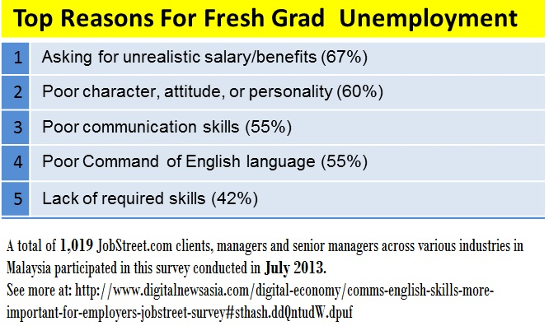
What about in Malaysia?
MISMATCH
Graduate Attributes
VS
INDUSTRY DEMAND OF ENGINEERS
High Unemployability Rate
Notes:
What about in Malaysia? Do we face similar problem?
Indeed we do. Jobstreet (a recruitment agency for Malaysia, Singapore, Vietnam and a few other countries) conducted a survey among employers. The employers found Malaysian graduates generally are poor in English, possess poor character and attitude, poor communication skills and asking for unrealistic salary.

Slide 6
TENSION between 2 NEEDS in engineering education:
The need to educate students as SPECIALISTS who possess a range of technologies with increasing levels of technical knowledge for professional mastery
The need to educate students as GENERALISTS who possess personal, interpersonal, product & system building skills

Slide 7
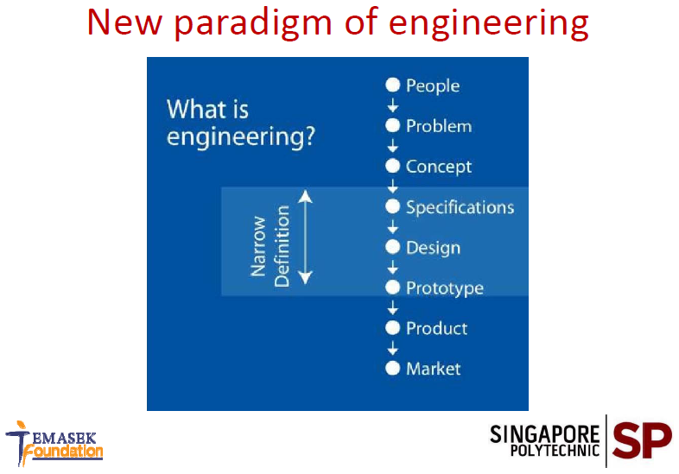
Notes:
Engineering is no longer limited to specifications, design and prototype but needs to take into account the society, environment, and the market.

Slide 8




CDIO: the initiators
CDIO concept: late 1990s
Massachusetts Institute of Technology (MIT)
CDIO initiative: 2000
MIT in collaboration with 3 Swedish Institutions: Chalmers University of Technology,
Linköping University
Royal Institute of Technology (KTH)
Notes:
To meet this challenges:
Meet this challenge by educating well-rounded engineers who understand how to Conceive-Design-Implement-Operate complex, value-added engineering products, processes and systems in a modern, team-based environment.

Slide 9

CDIO Initiative: who are involved?
CDIO Initiative
Academics
Industry
Accreditation Board
Students
Notes:
Accreditation Board for Engineering and Technology (ABET)

Slide 10


STEPS in developing CDIO framework by applying engineering problem-solving paradigm:
Develop a set of skills needed by engineers
Develop new approaches to enable the learning of these skills
Exploring new system to assess technical learning
Using the assessment to improve education process

Slide 11
5 engineering tracks and the specific set of skills which support them (Crawley et al, 2011):
The Researcher – Experimentation and Knowledge Discovery (2.2)
The System Designer – System Thinking (2.3), Conceiving and Engineering Systems (4.3)
The Device Designer/Developer –Designing (4.4), Implementing (4.5)
The Product Support Engineer/Operator –Operating (4.6)
The Entrepreneurial Engineer/Manager –Enterprise and Business Context (4.2)

Slide 12

GENERIC SET OF SKILLS NEEDED
BY ALL ENGINEERS (Crawley et al, 2011):
(2.1) Engineering Reasoning and
Problem Solving
(2.4) Personal
(2.5) Professional Skills
and Attitudes
(3.1) Teamwork
(3.2) Communications
(4.1) External and societal context

Slide 13
The general objective of the CDIO Syllabus which summarizes a set of knowledge, skills, and attitudes that alumni, industry, and academia desire in a future generation of young engineers.
1. Technical knowledge & reasoning
2. Personal & Professional Skills
3. Inter
personal skills
4. CDIO in the enterprise & societal context
Graduating engineers should be able to:
conceive-design-implement-operate
complex value-added engineering systems
in a modern team-based environment

Slide 14
What is CDIO?
Innovative educational framework
applied in engineering education programs
based on engineering fundamentals of:
CONCEIVING
DESIGNING
IMPLEMENTING
OPERATING
real world systems and products
to produce next generation engineers

Slide 15
CDIO Initiative & Approach Today …
Implemented in 116 schools/ institutions globally
In 2001, CDIO Syllabus Version 1 was proposed
In 2004, 12 standards to describe CDIO programs were adopted
In 2010 – Australia (3); Belgium (2); Canada (5); Chile (3); China (4); … Malaysia (1) – School of Engineering at Taylor’s University; Singapore (2) – Nanyang Polytechnic & Singapore Polytechnic; Sweden (5), England (5); USA (14); Vietnam (2)
Retrieved 21 Nov 2014 from www.cdio.org/meetings-events
& and www.en.m.wikipedia.org/wiki/CDIO

Slide 16
CDIO Approach
Education that …
stresses the fundamentals
set in the context of conceiving, designing, implementing and operating products, processes and systems
Strives to make engineering attractive to students in order to retain them in the program and in the profession

Slide 17
The CDIO Initiative – 3 Goals
To educate students who are able to:
Master a deeper working knowledge of technical fundamentals.
Lead in the creation and operation of new products, processes, and systems.
Understand the importance and strategic impact of research and technological development on society
Do we NOT want our students be to like these?

Slide 18
CDIO is
CDIO
F/W for Engineering Education (TVET education)
for curriculum design
for T & L instruction & delivery
for assessment
related to real-world environment
systems & product
suitable also for Non-Engineering Education

Slide 19

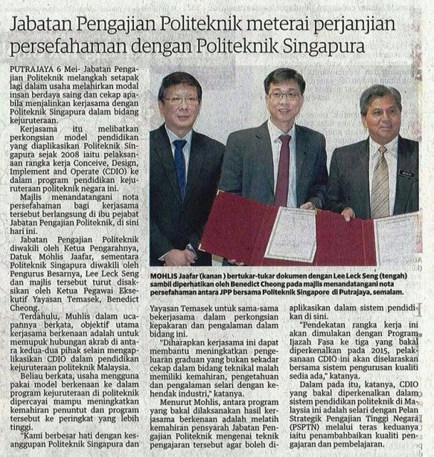
NoU between Dept. of Polytechnic Education & Singapore Polytechnic on 6 May 2014 at Galeria PjH, JPP.

Slide 20
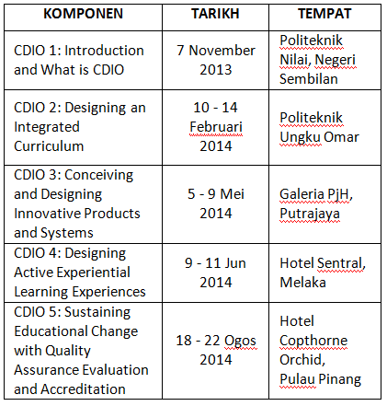
CDIO TRAINING WORKSHOPS JOINTLY ORGANIZED BY TEMASEK FOUNDATION, SINGAPORE POLYTECHNIC AND POLITEKNIK MALAYSIA IN 2013-2014

Slide 21




Defining customer needs; considering technology, enterprise strategy, and regulations; developing concepts, techniques and business plans
Conceive
Creating the design; the plans, drawings, and algorithms that describe what will be implemented
Design
The transformation of the design into the product, including manufacturing, coding, testing and validation
Implement
Using the implemented product to deliver the intended value, including maintaining, evolving and retiring the system.
Operate

Slide 22
Current vs CDIO: Where are we now??
 | Current |  | CDIO
1. | Learning outcomes heavy on “what we think students are capable of doing” | 1. | Learning outcome is determined by what is expected of graduates in future employment (e.g. job competency)
2. | Courses are still largely “independent”, that is compartmentalized learning. Disconnect between C-D-I-O, not integrative. | 2. | Courses are integrated to support CDIO initiative.
3. | Assessment heavy on testing knowledge – quizzes, tests, examinations, reports | 3. | CDIO elements are assessed mainly on application of knowledge – process, rubrics etc.

Slide 23
TO CLOSE THE GAP: CDIO INITIATIVE
a curriculum organized around mutually supporting courses, but with CDIO activities highly interwoven
rich with student design-build-test projects
Related to the societal and environmental concerns
integrating learning of personal & professional skills: teamwork & communication
featuring active & experiential learning
constantly improved through quality assurance & accreditation

Slide 24
CDIO Overview
The Teaching & Learning activities in the CDIO initiative are based on TWO key documents:
What: CDIO Syllabus |  | How: 12 Standards of Best Practices
Disciplinary Knowledge (Learning to Know) | Knowledge of underlying maths & sciences, Core fundamental knowledge Advanced fundamental knowledge | Curriculum | Standards 1, 2, 3, 4
Personal Skills (Learning to Be) | Analytical reasoning & Problem solving, Experimentation & knowledge discovery, System thinking, Personal skills and attributes, Professional skills & attributes | T & L Activities | Standards 5, 7, 8
Interpersonal Skills (Learning to Live Together) | Multi-disciplinary teamwork Communications Communication in a foreign language* | Assessment | Standards 11, 12
CDIO Skills (Learning to Do) | Conceiving, Designing, Implementing & Operating Systems in the Enterprise/Business & External/ Societal Context Conceiving and engineering/technology systems Designing/ Formulate Implementing/ Develop/Produce Operating/ Evaluate | Faculty Competence | Standards 9 & 10
 |  | Workspace | Standards 6

Slide 25

Technical Knowledge & Reasoning:
  Knowledge of underlying sciences
  Core engineering fundamental knowledge
  Advanced engineering fundamental knowledge
Personal and Professional Skills & Attributes
  Engineering reasoning and problem solving
  Experimentation and knowledge discovery
  System thinking
  Personal skills and attributes
  Professional skills and attributes
Interpersonal Skills: Teamwork & Communication
  Multi-disciplinary teamwork
  Communications
  Communication in a foreign language
Conceiving, Designing, Implementing & Operating Systems in the Enterprise & Societal Context
  External and societal context
  Enterprise and business context
  Conceiving and engineering systems
  Designing
  Implementing
  Operating
  Leading Engineering Endeavours
  Enterpreneurship

Slide 26
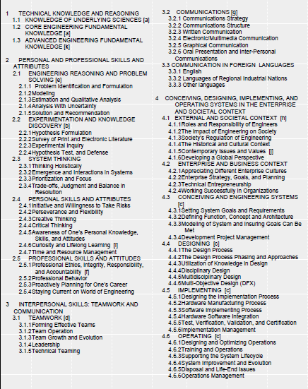
CDIO Syllabus

Slide 27


How CDIO syllabus relates to
UNESCO 4 Pillars of Learning
(2001)
UNESCO (Delors et. al, 1996)
Technical knowledge & reasoning
Conceiving, Designing, Implementing & Operating Systems in the enterprise, societal and environmental context
Interpersonal Skills: Teamwork & communication
Personal and Professional Skills & Attribute
Learning to know
Learning to do
Learning to live together
Learning to be

Slide 28

9 MQA Focus Areas vs 12 CDIO Standards
1 | Vision, mission, educational goals and learning outcomes
2 | Curriculum design and delivery
3 | Assessment of students
4 | Student selection and support services
5 | Academic staff
6 | Educational resources
7 | Programme monitoring and review
8 | Leadership, governance and administration
9 | Continual quality improvement
1 | CDIO as Context
2 | CDIO Syllabus Outcomes
3 | Integrated Curriculum
4 | Introduction to Engineering
5 | Design-Build Experiences
6 | CDIO Workspaces
7 | Integrated Learning Experiences
8 | Active Learning
9 | Enhancement of Faculty CDIO Skills
10 | Enhancement of Faculty Teaching Skills
11 | CDIO Skills Assessment
12 | CDIO Program Evaluation

Slide 29
MQA Learning Domains vs CDIO Syllabus
LDs
1 | Knowledge of discipline area
2 | Technical Skills/ Practical Skills
3 | Values, Attitudes, Professionalism
4 | Social Skills and Responsibilities
5 | Communication, Leadership and Teamworking Skills
6 | Problem Solving and Scientific Skills
7 | Information Management and Lifelong Learning Skills
8 | Managerial and Entrepreneurial Skills
1 | Technical Knowledge and Reasoning
2 | Conceiving, Designing, Implementing & Operating Systems in the enterprise, societal and environmental context
3 | Interpersonal Skills: Teamwork & communication
4 | Personal and Professional Skills & Attribute
OBE in Malaysian Polytechnic

Slide 30
Polytechnic’s OBE Learning Domains vs CDIO Syllabus
LDs | OBE
1 | Knowledge
2 | Practical Skills/ Technical Skills
3 | Communication Skills
4 | Critical Thinking and Problem Solving Skills
5 | Social Skills and Responsibilities
6 | Continuous Learning and Information Management Skills
7 | Management and Entrepreneurial Skills
8 | Professionalism, Ethics and Moral
9 | Leadership and Teamwork Skills
1 | Technical Knowledge and Reasoning
2 | Conceiving, Designing, Implementing & Operating Systems in the enterprise, societal and environmental context
3 | Interpersonal Skills: Teamwork & communication
4 | Personal and Professional Skills & Attribute
OBE in Malaysian Polytechnic

Slide 31
12 CDIO STANDARDS:
CDIO as the Context
Learning Outcomes
Integrated Curriculum
Introduction to Engineering
Design-Implement Experience
Engineering Workspaces
Integrated Learning Experiences
Active Learning
Enhancement of Faculty CDIO Competence
Enhancement of Faculty Teaching Competence
Learning Assessment
Programme Evaluation

Slide 32
Standard #1: CDIO as the Context
For more meaningful and effective engineering and technology education
CDIO as the Context
Is used even from Semester 1 although learning activities may place more emphasis on Design – Implement – Operate rather than Conceive.

Slide 33

The Marshmallow Challenge

Slide 34
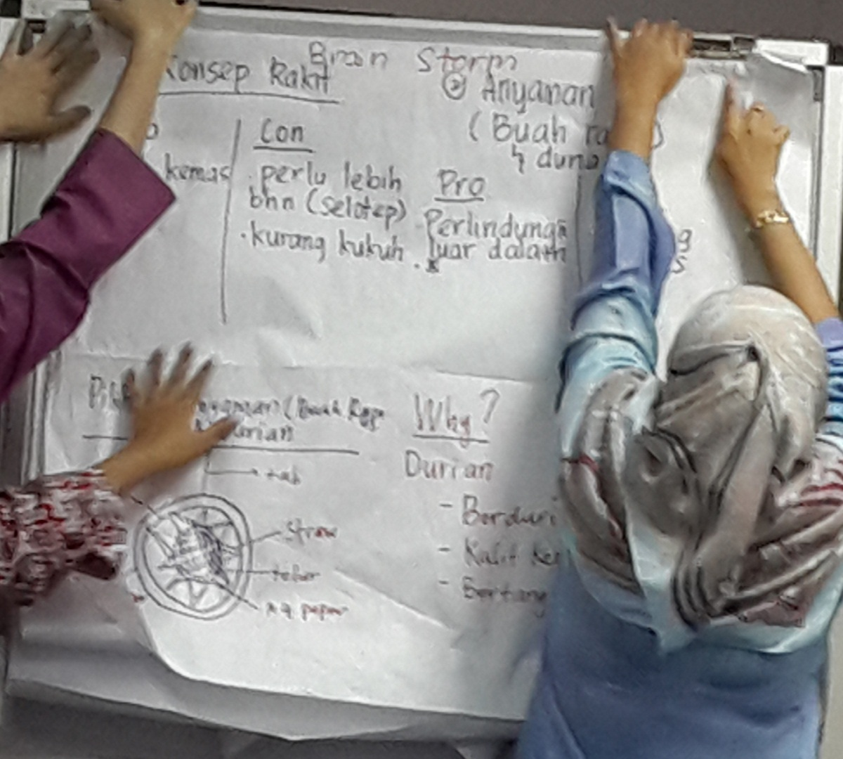
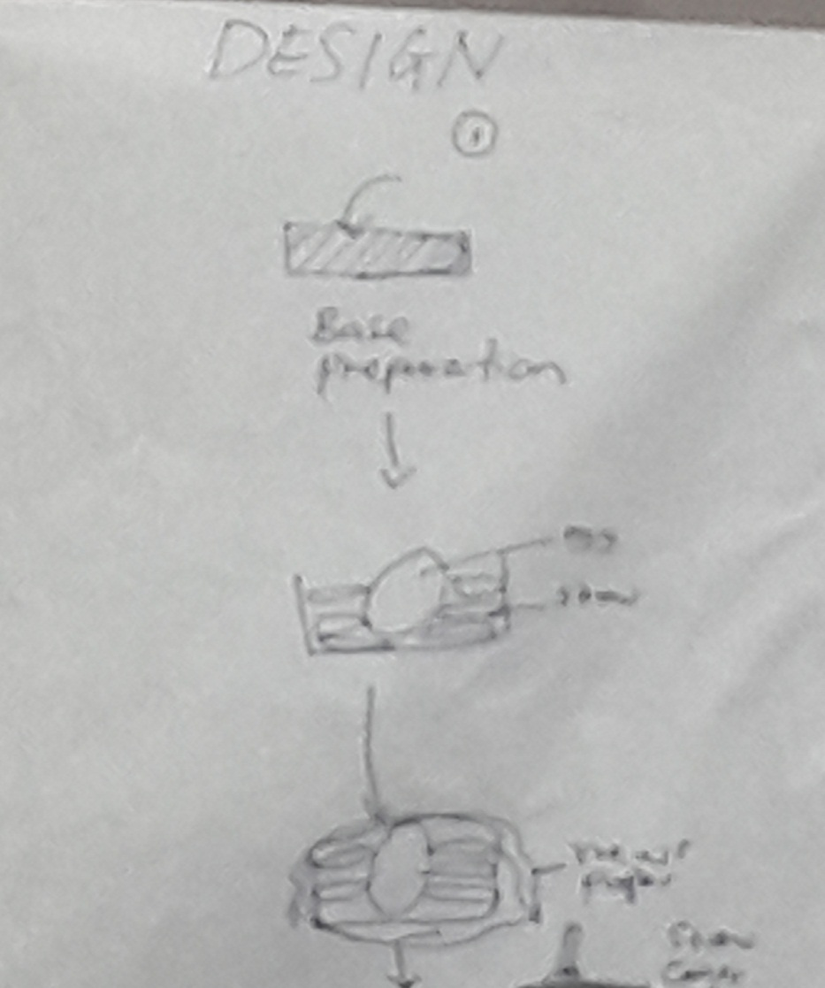
Marshmallow Debriefing …
Conceive …
Design …

Slide 35
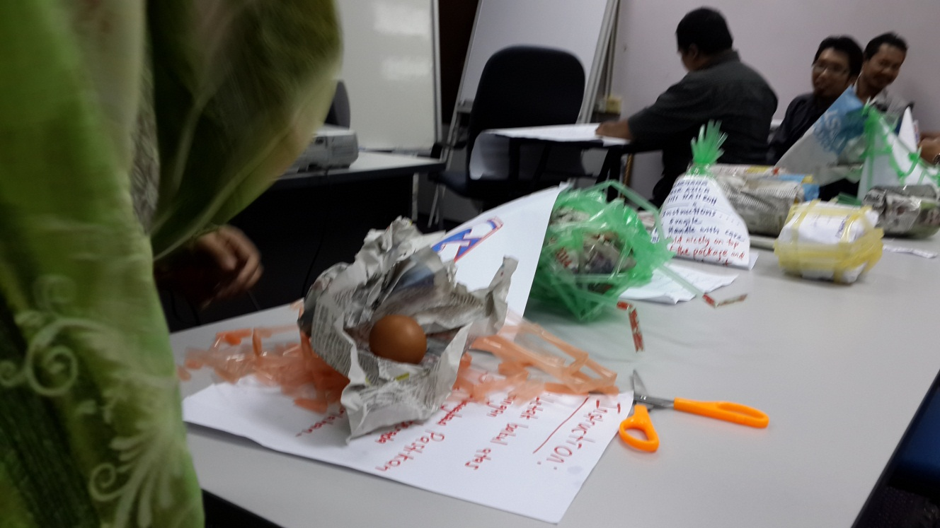
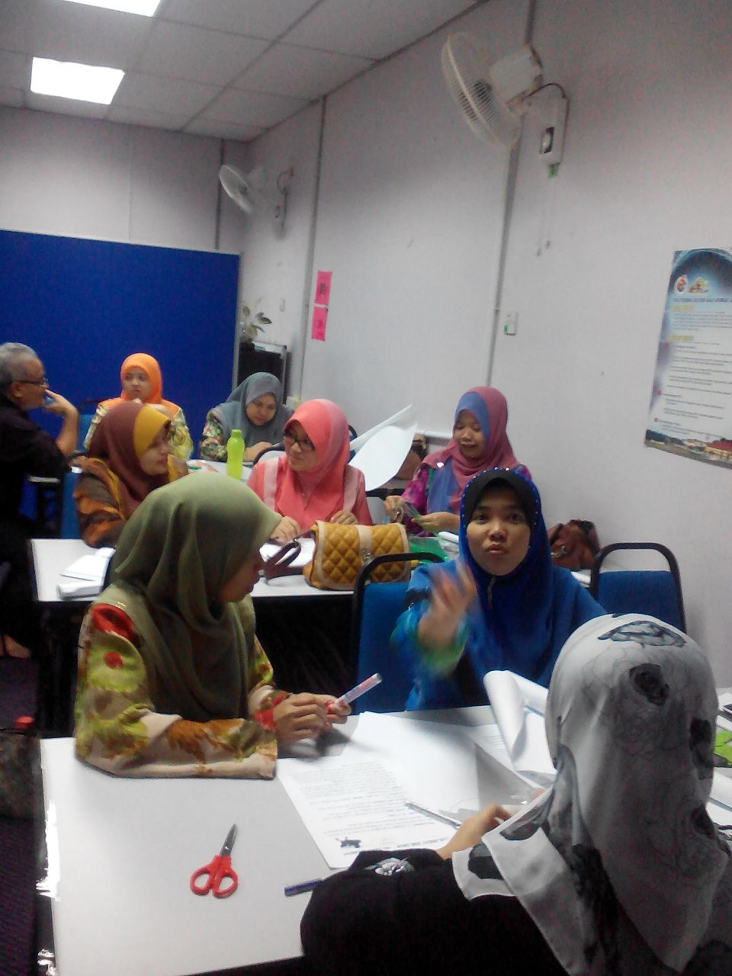
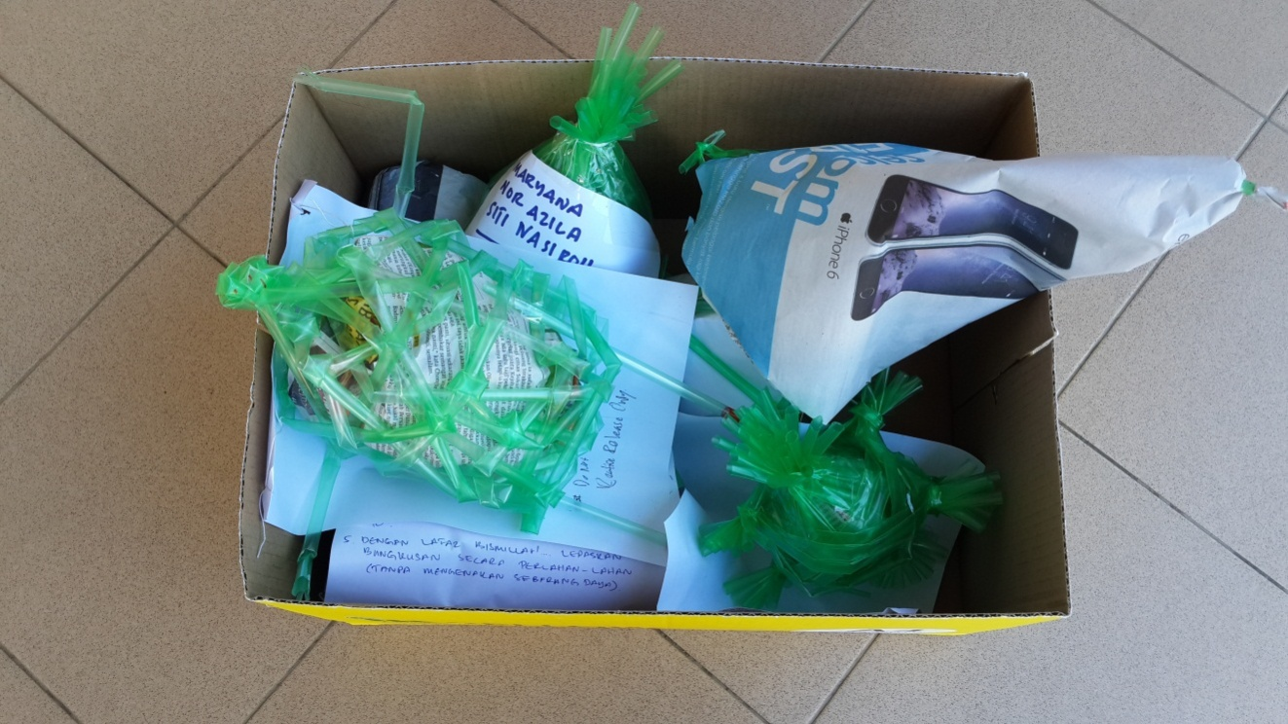
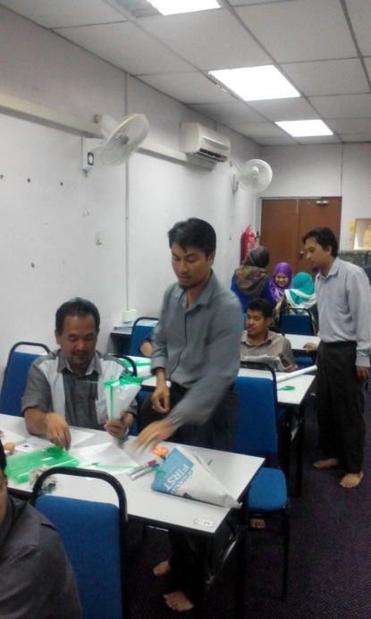
Eggsperiment Debriefing …
Implement …

Slide 36
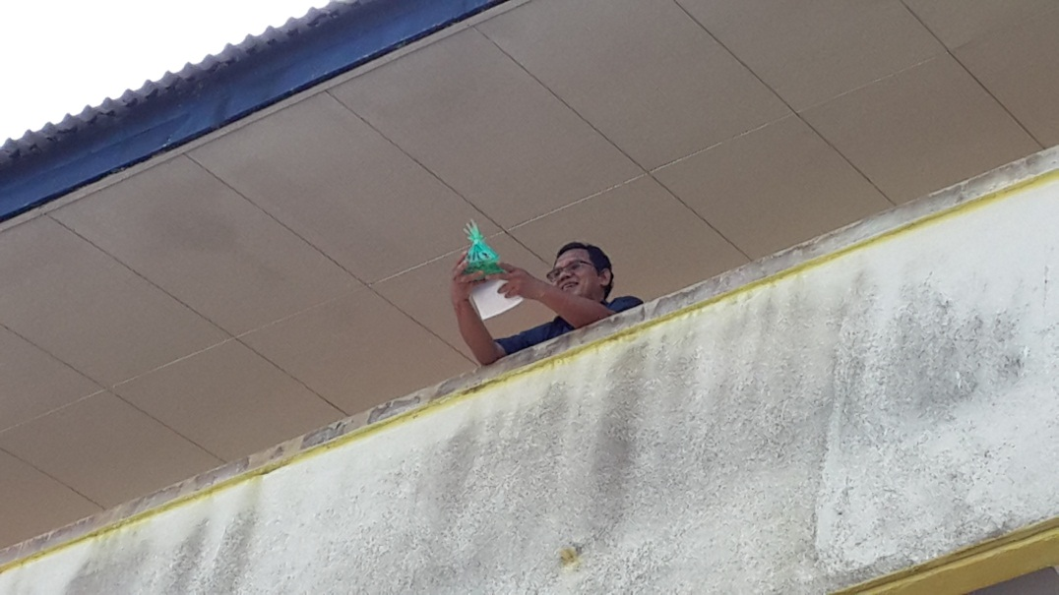
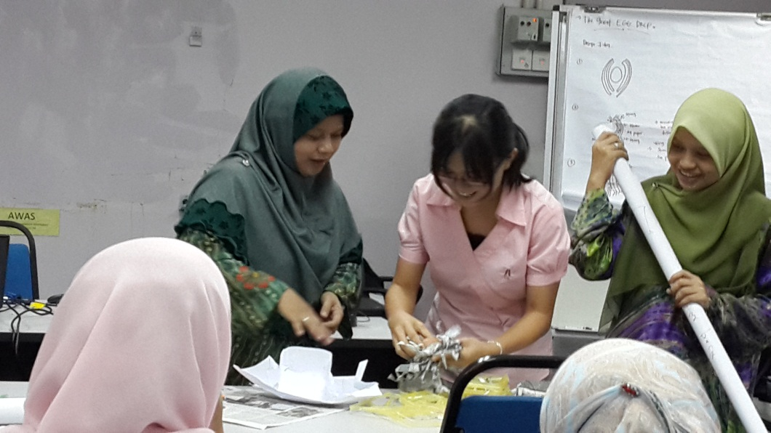
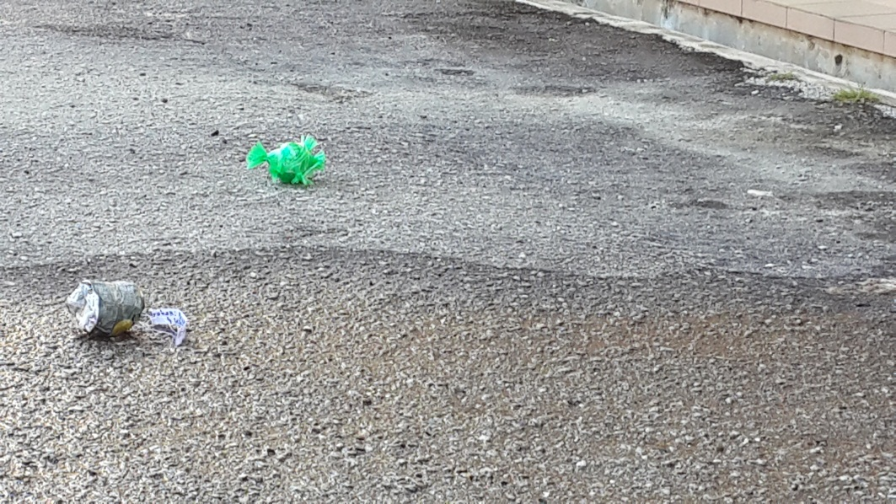
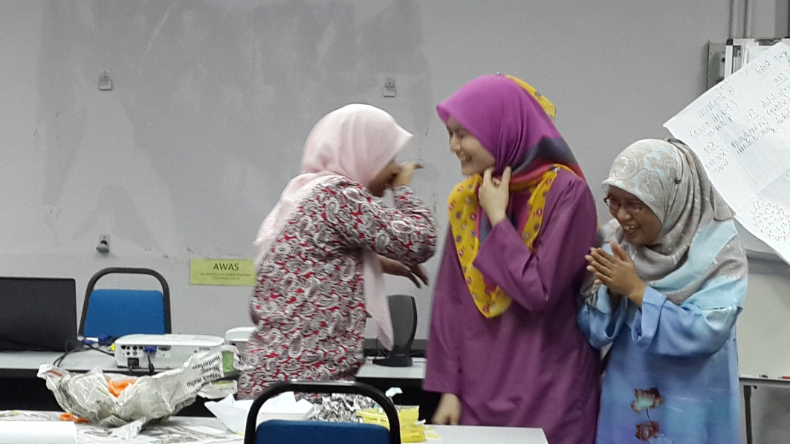
Eggsperiment Debriefing …
Operate

Slide 37
CDIO Approach
A few pointers to bear in mind …
CDIO advocates conceiving, designing, implementing and operating in the context of real life situations - societal, external, enterprise or business needs
CDIO teaches more explicitly skills such as brainstorming, critical thinking and teamworking
CDIO promotes integration of courses/ modules
CDIO encourages interdisciplinary collaboration e.g. mechanical engineering, food technology, biotechnology & design etc.

Slide 38
What is CDIO?
Innovative educational framework
applied in engineering education programs
based on engineering fundamentals of:
CONCEIVING
DESIGNING
IMPLEMENTING
OPERATING
real world systems and products
to produce next generation engineers
Notes:
Recapping …

Slide 39
Singapore Polytechnic Mechanical Engineering Year 1 Project – Formula 1 Model Racing Car
Example 2:
The design-build project is a model racing car consists of two parts:
Designing and modelling of racing car body are conducted in the course “Innovation, Design and Enterprise in Action” (IDEA)” course
Machining of racing car chassis is conducted in “Introduction to Engineering” course
Integration of courses

Slide 40
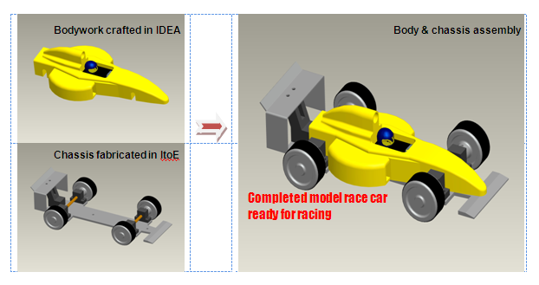
Design-build project – Year 1
Note: Acronym of Courses in the Mechanical Engineering Program
IDEA - “Innovation, Design and Enterprise in Action” (IDEA)
ItoE – “ Introduction to Engineering”

Slide 41
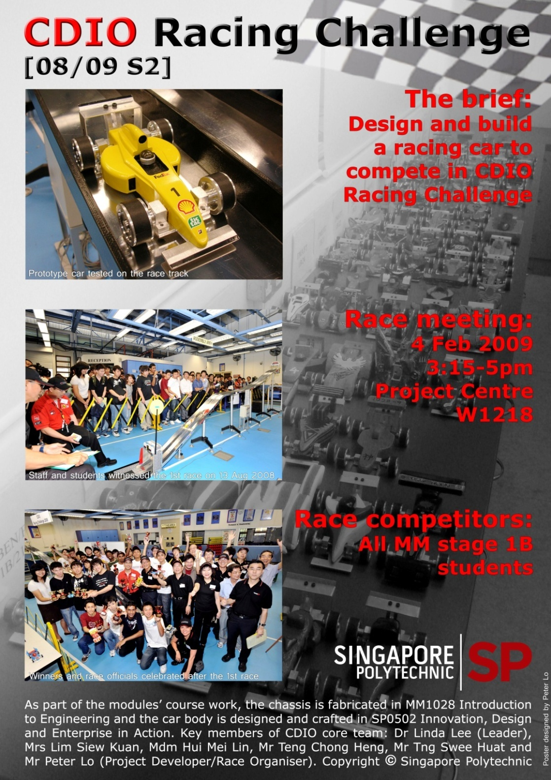
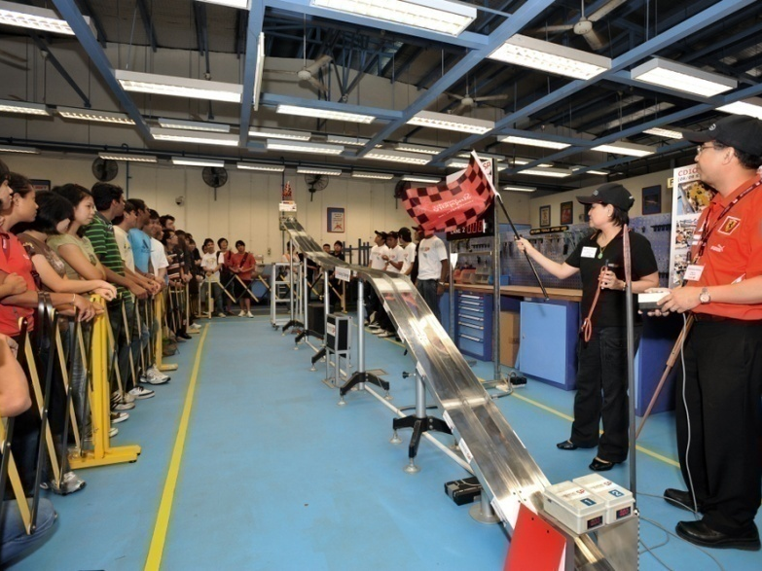
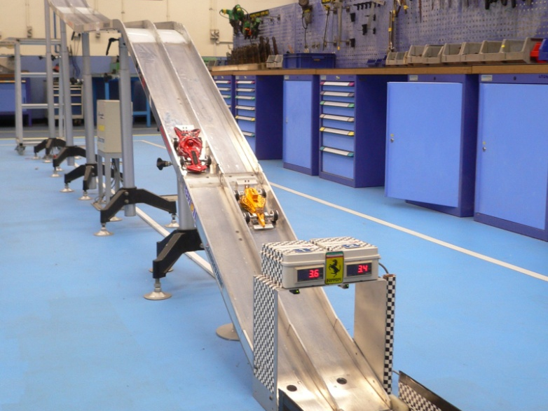
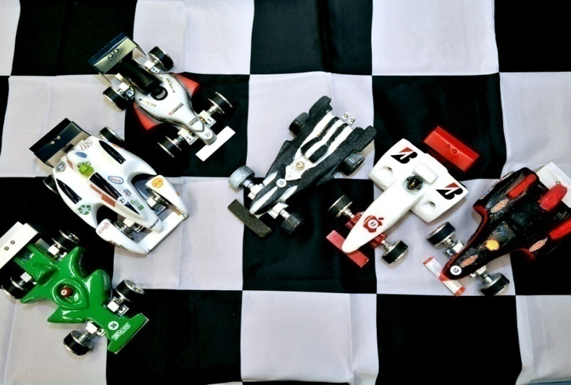

Slide 42
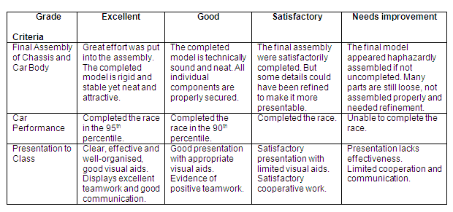
Rubric for the final assessment
Students are assessed through critique sessions

Slide 43
Example 3:
University of Liverpool Embedment of CDIO into Civil Engineering Program
3 Progressive Design – Build – Test Projects:
Icebreaker project
Introduction for all Engineering students
Build and test of model cardboard bridge
2 – Week Bridge # 1
3. 2 – Week Bridge # 2

Slide 44
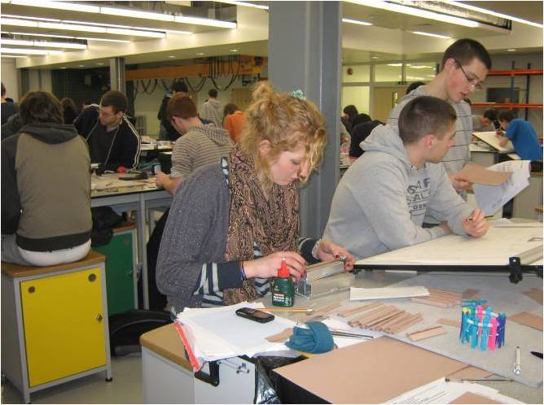
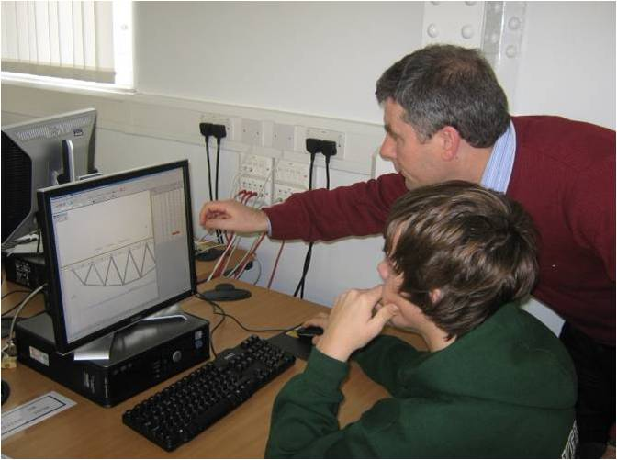
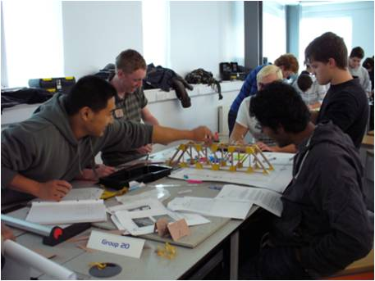
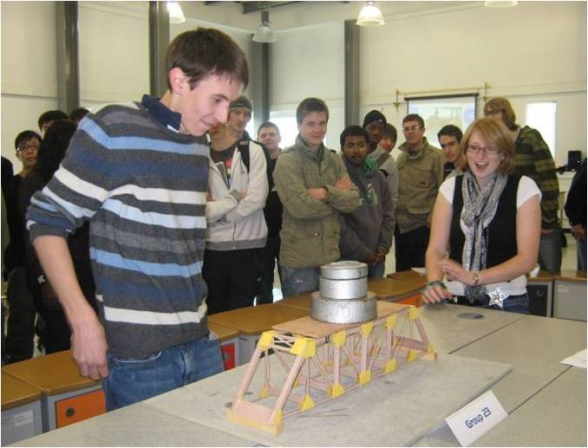
1. Icebreaker project - 6 students, tutor group

Slide 45
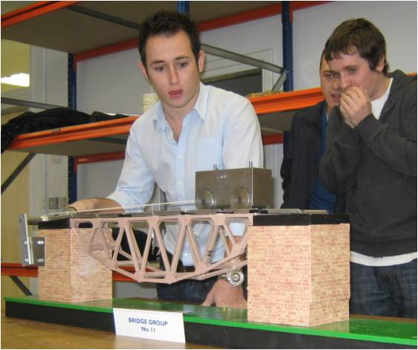
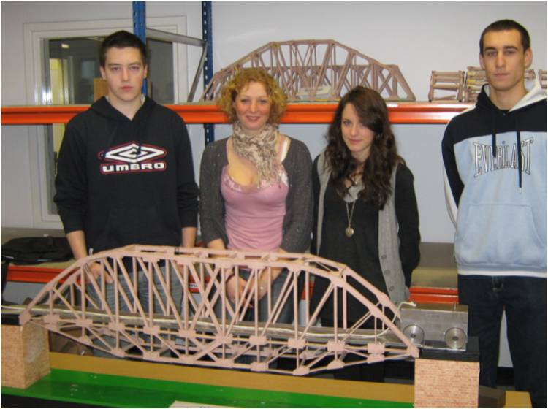
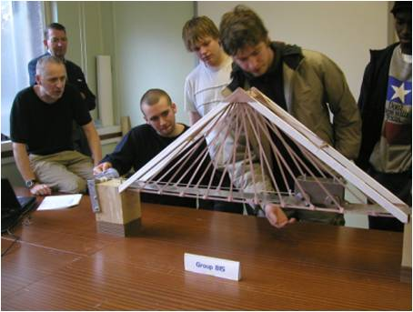
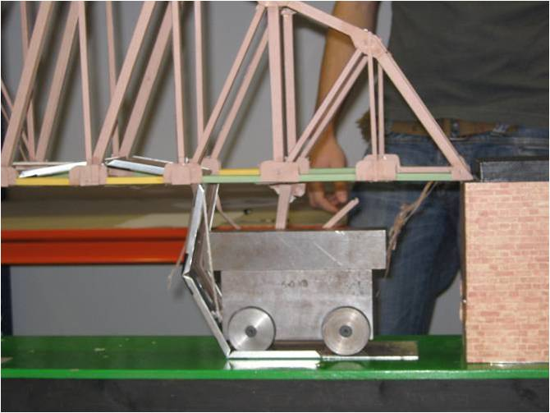
2. 2- Week Bridge # 1
Deck truss – rolling load
Through and Deck Truss !
Innovative concept design
Collapse of the deck cross-beams

Slide 46
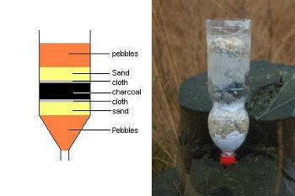
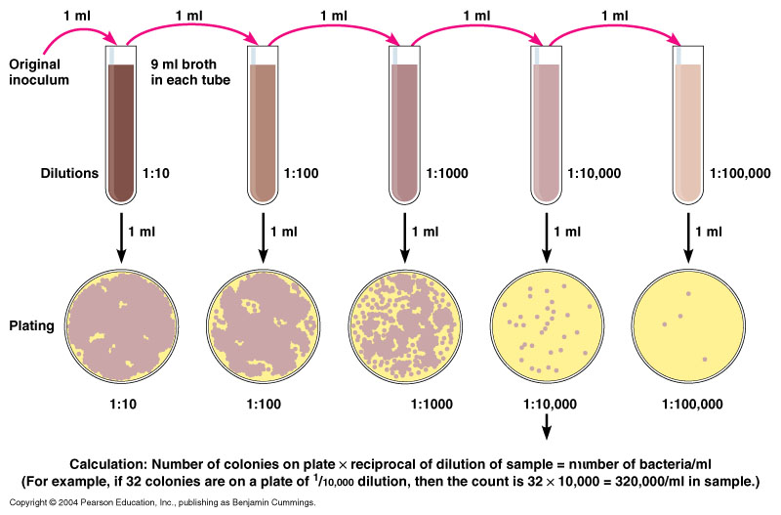

What about for JTM Year 1 Project?
Design a water filter with given materials:
Gravel, sand, aquarium pebbles, coconut fibre, wood chips, cockle shells, and 1 other item you can choose (but not more than RM10).

Slide 47
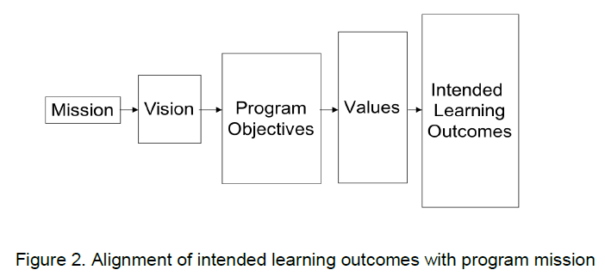
Standard #2: Learning outcomes

Slide 48
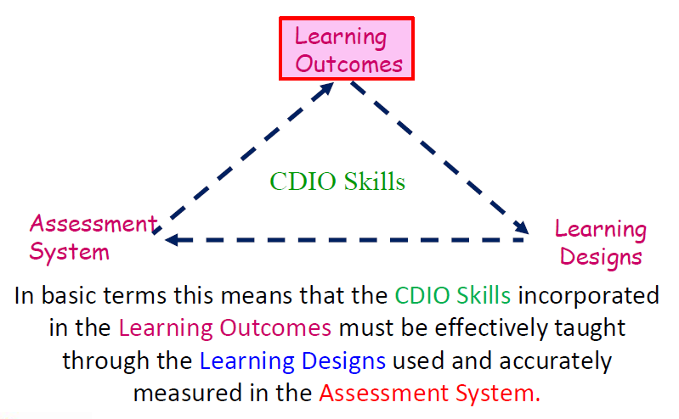
Briggs Model (Ref??)

Slide 49
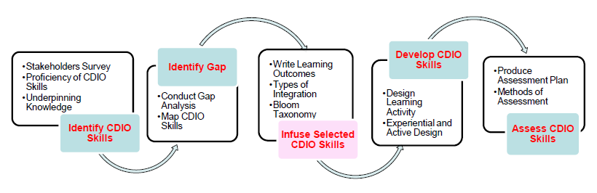
Standard #3: Integrated curriculum
A curriculum designed with mutually supporting disciplinary courses, with an explicit plan to integrate …
personal,
interpersonal,
product, process, and system building skills

Slide 50
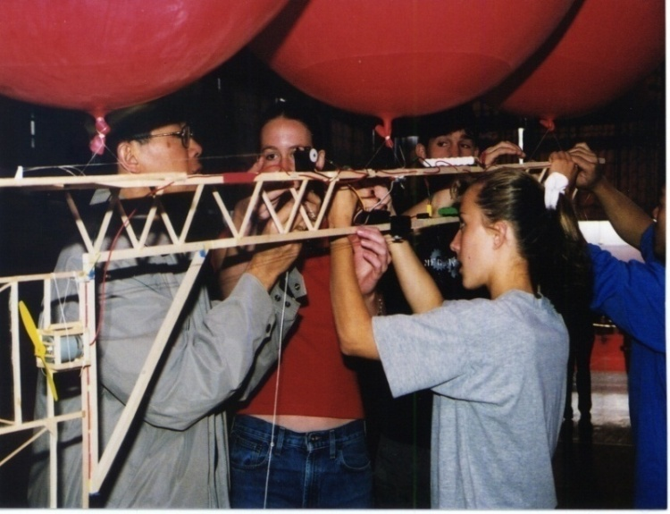
Standard 4 – Introduction to Engineering
An introductory course to the engineering profession and Project 1 (stresses D, I & O).
To motivate students to study engineering
To provide a set of personal experiences which will allow early fundamentals to be more deeply understood
To provide early exposure to system building
To teach some early and essential skills (e.g. teamwork, thinking skills)
Capstone
Disciplines
Intro
Sciences

Slide 51
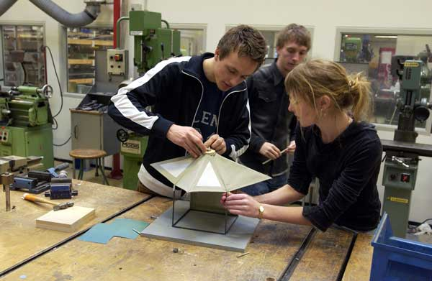

Std #5: Design-implement experience
Design-Build Experiences/ Formulate-Develop Experiences/ Develop-Produce
Provide authentic activities onto which more abstract learning can be mapped
Provide the natural context in which to teach many CDIO syllabus skills (teamwork, communications, designing, implementing)
Reinforce by application previously learned abstract knowledge, to deepen comprehension
DTU Design & Innovation Lightweight Shelter Project

Slide 52
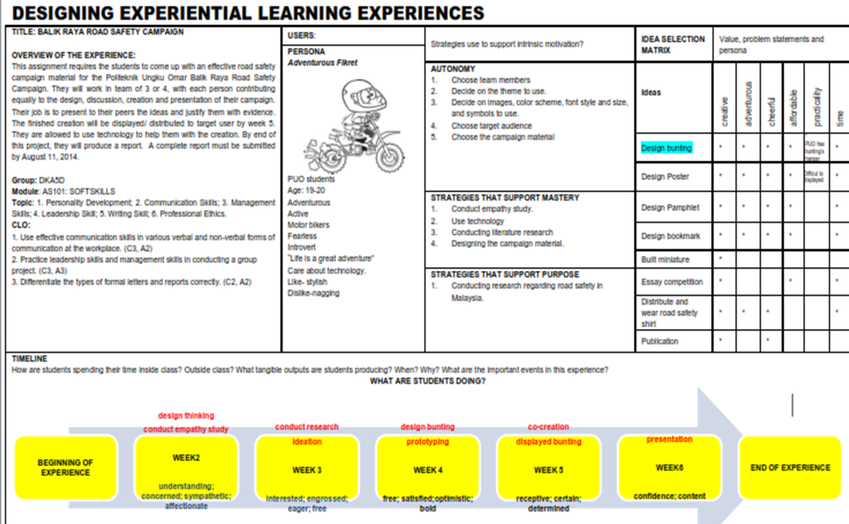
Std #5: Design-implement experience
Dr Zuraidah (PUO) designing and implementing an active-experiential learning for students undertaking AS101 Softskills module

Slide 53
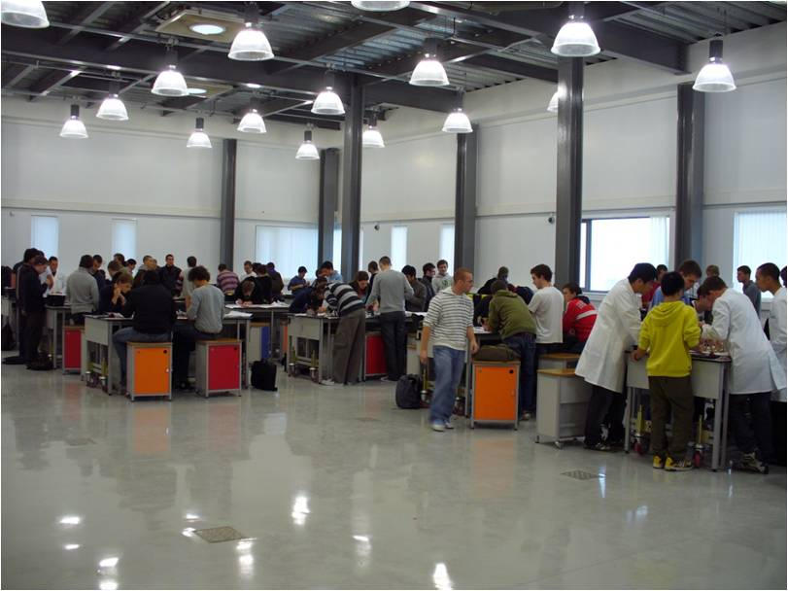
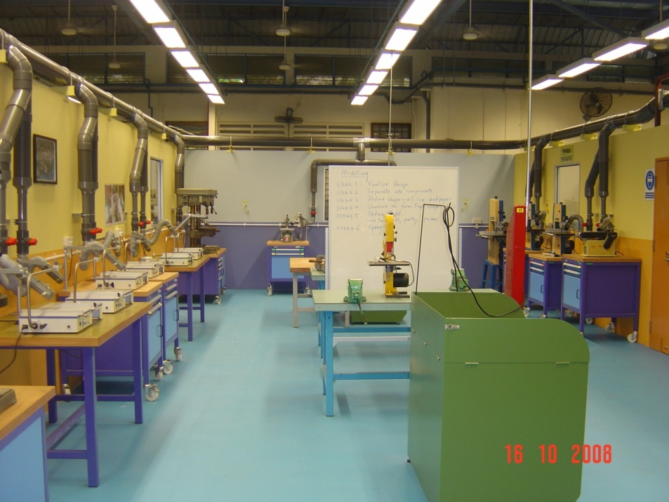
Std #6: Work Spaces
Active Learn Laboratory provides space for up to 300 students engaged in active learning/ model making (Singapore Polytechnic)
Active Learn Laboratory provides space for up to 300 students engaged in active learning (Univ of Liverpool)

Slide 54
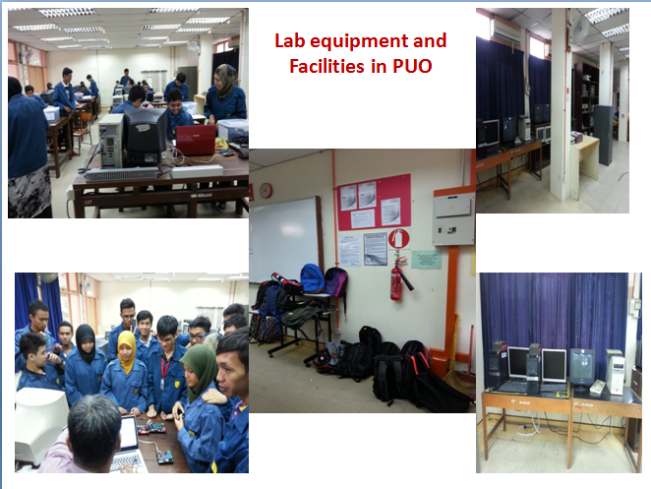

Slide 55

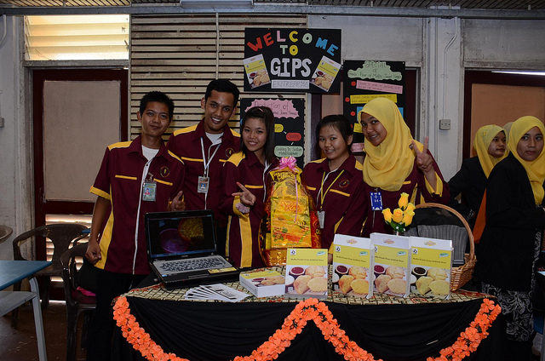
Std #7: Integrated learning experience
Integrate disciplinary knowledge, Interpersonal skills, personal skills and CDIO skills e.g. in Projects and Capstone Projects.
In disciplinary subjects, it is possible to construct learning exercises which integrate both technical learning and learning of CDIO Syllabus skills (problem solving, system thinking, experimentation, etc.)
It is important for students to see their role models, the engineering faculty, involved with issues such as ethics, communication, enterprise and societal issues.

Slide 56
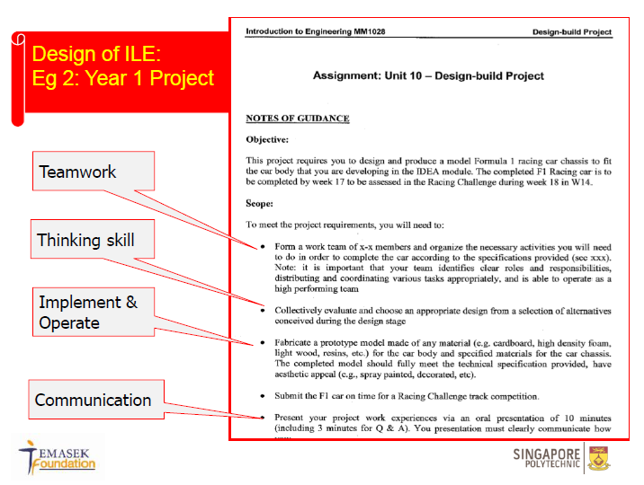
Std #7: Integrated learning experience

Slide 57
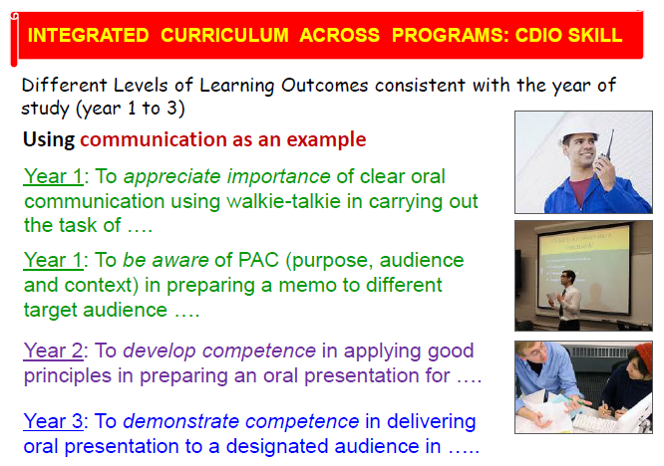
Std #7: Integrated learning experience

Slide 58
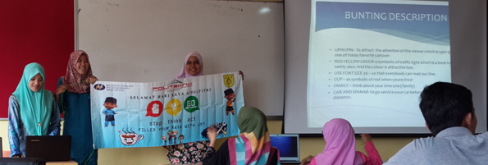
Std #7: Integrated learning experience

Slide 59


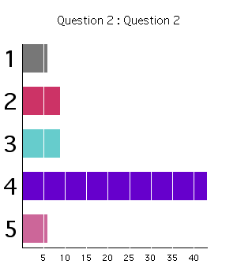
Realtime Personal Response System (PRS)
Std #8: Active Experiential Learning
Active learning techniques stress students’ active involvement in their own learning; rather than simply passively listening
Project-based and design-build courses = active learning
Lecture-based courses can include one or several active learning strategies, concept questions, gallery walk, cooperative learning, and turn-to-your-partner discussions.

Slide 60
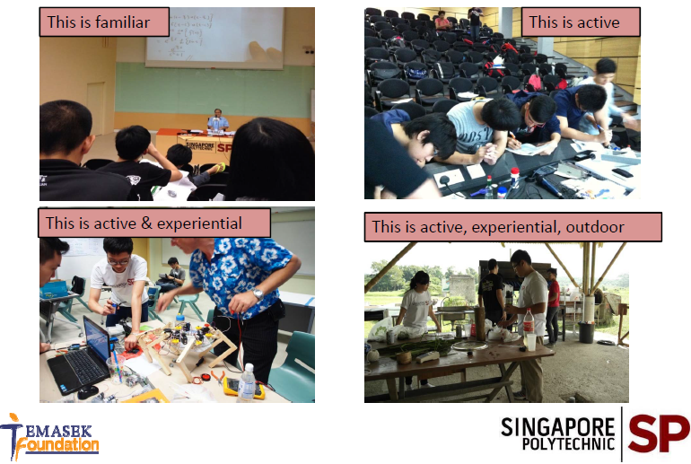
Std #8: Active Experiential Learning

Slide 61

Std #8: Active Experiential Learning

Slide 62

Standard #9: Enhancement of faculty CDIO Competence

Slide 63

Standard #9: Enhancement of faculty CDIO Competence
Pn. NorHasmi from PUO conducting an “Intro to CDIO” session for Civil Engineering lecturers in her polytechnic.

Slide 64

Standard #9: Enhancement of faculty CDIO Competence

Slide 65


Slide 66

Standard # 10: Enhancement of Faculty Teaching Competence
Source: Dr Mohd Daud Isa. 3 things that I have learnt. Powerpoint presentation. CDIO 5. August 2014, Copthorne Orchid Penang

Slide 67
Standard # 10: Enhancement of Faculty Teaching Competence
Professional Development courses – Adult Learning, Active Learning Strategies, Learning Styles, Item Building Course, E-Learning course, etc

Slide 68


Standard #11: CDIO Skills Assessment
Assessment of student learning in personal, interpersonal, and product and system building skills, as well as in disciplinary knowledge
Standard #12: CDIO Program Evaluation
A system that evaluates programs against these 12 standards, and provides feedback to students, faculty, and other stakeholders for the purposes of continuous improvement

Slide 69

Standard #11: Learning Assessment
Standard #12: Programme Assessment

Slide 70


Slide 71


Slide 72

CDIO Council
Chalmers, Linköping, Queen’s², USNA, KTH, MIT, DTU, U. Pretoria
Africa Regional Centre
U. Pretoria
N. American Regional Center
MIT
UK-Ireland Regional Center
Queen’s, Belfast
U. Liverpool
Nordic Regional Center
Chalmers U.
KTH
Linköping
Future regional centers
Regional Collaborators
California State U., Northridge
Daniel Webster College
École Polytechnique, Montreal
Queen’s U. Kingston, Ont.
US Naval Academy
U. Colorado, Boulder
Regional Collaborators
U. Bristol
Lancaster University
Regional Collaborators
Technical U. of Denmark
Umeå University
Meetings
Regular Regional Meetings
Council Meetings
CDIO Annual Conference
Unaligned Collaborators
Hochschule Wismar
Hodgeschool Gent
Shantou U.
Singapore Polytechnic
U. Auckland
U. Sydney

Slide 73



Visit www.cdio.org!

Slide 74

REFERENCE:
Crawley, E.F. (2001). The CDIO syllabus. A statement of goals for undergraduate engineering education. Massachusetts: MIT
Crawley, E.F. (2002). Creating the CDIO syllabus, a universal template for engineering education. 32nd ASEE/IEEE Frontiers in Education Conference, Nov 6-9, 2002, Boston.
Crawley, E.F., Malmqvist, J., Lucas, W. A., & Brodeur, D.R. (2011). The CDIO syllabus v2.0. An updated statement of goals for engineering education. In Proceedings of the 7th International CDIO Conference, Technical University of Denmark. Copenhagen: June 20-23, 2011.
Delors, J. et al. (1996). The treasure within: Report to UNESCO of the International Commision on Education for the 21st century. Paris: UNESCO Publishing.

Slide 75

Thank you.

